Slide 1
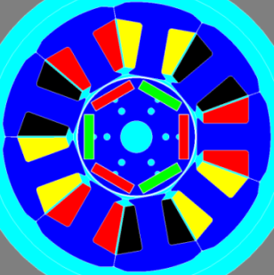
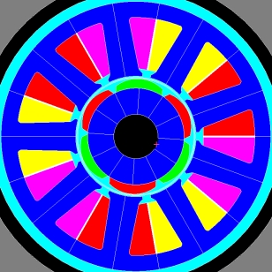
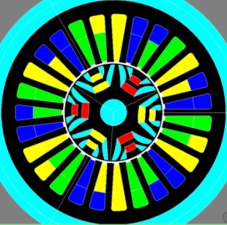
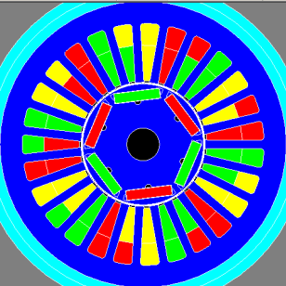
Motivation: Volume and Grade Reduction of Rare Earth Magnets.
Synchronous Reluctance Motor Aided by Permanent Magnets
 | S550 | BMW SPM 9s6p | 27s6p PMSynRM | 27s6p PMSynRM | C1xx IPM 27s6p
Parallel Paths | 3 | 3 | 3 | 3 | 3
Turns x coil | 22 | 22 | 6 | 6 | 6
ODRotor / L | 37.1mm / 43mm | 36.4mm / 36mm | 37.1mm / 56mm | 37.1mm / 56mm | 37.1mm / 42mm
PM volume | 1.08e-5 m3 NdFeB N38SH Br=1.24 mur=1.071 | 0.86e-5m3 (Shaped) NdFeB N38SH Br=1.24 mur=1.071 | 0.97e-5 m3 MAGFINE SmFeN P12 Br=0.92 mur=1.23 | 0.97e-5 m3 NdFeB N27 Br=1.03 mur=1.03 | 0.89e-5 m3 NdFeB N35 Br=1.165 mur=1.071
J Slot – K surf | 8.7A/mm2 –123A/mm @ 108 Amp | 8.7A/mm2 –123A/mm @ 108 Amp | 7.63A/mm2 –123A/mm @ 130 Amp | 7.63A/mm2 –123A/mm @ 130 Amp | 7.63A/mm2 –123A/mm @ 130 Amp
Cogging | 23 mNm (p) | 13 mNm (p) | 4 mNm (p) | 3 mNm (p) | 10 mNm (p)
Tavg | 4.12 Nm (4.19-4.03) | 3.79 Nm (3.82-3.76) | 4.18 Nm (4.32-4.06) | 4.5 Nm (4.61-4.31) | 4.5 Nm (4.55-4.45)
Ripple(Nm) | 0.16/4.10 = 3.9% | 0.06/3.79 = 1.5% | 0.25 = 6% | 0.3/4.5 = 6% | 0.1/4.5 = 2.2%
BEMF line | 4.3(1st) | 4.46(1st) | 1.65(1st) | 2(1st) | 3.5(1st)
Permanent Magnets “Compatible” with the PMSynRM Design
Injection Molded MagFine SmFeN P12 Br=0.92 mur=1.23
Sintered NdFeB N27 Br=1.03 mur=1.03
Compression Molded NdFeB-12L Br=0.8 mur=1.26
Sintered SmCo24 Br=0.96 mur=1.05
Neodymium Iron Boron
Samarium Cobalt

Slide 2
Cost Breakdown (Magnets): Based on Low Quantity Cost
Provided by Bomatec
NdFeB per piece (1.31gr)
NdFeB per Kg
 | H (120C) | SH (150C) | EH (180C)
38 | $0.72 | $0.83 | $1.38
35 | $0.71 | $0.76 | $1.23
33 | $0.70 | $0.73 | $1.18
30 | $0.68 | $0.70 | $1.15
 | H (120C) | SH (150C) | EH (180C)
38 | $549 | $633 | $1053
35 | $542 | $588 | $939
33 | $534 | $557 | $900
30 | $519 | $534 | $878
Materials cost BMW
9s6p SPM 39mm
$50.6
Materials cost
27s6p PMSynRM 44mm
$38.5
 | H (120C) | SH (150C) | EH (180C)
38 | 1 | 1 | 1
35 | 0.98 | 0.91 | 0.89
33 | 0.97 | 0.88 | 0.86
30 | 0.94 | 0.84 | 0.83
 | H (120C) | SH (150C) | EH (180C)
38 | - | $169 | -
35 | - | - | -
33 | - | - | -
30 | - | $142 | -
Materials cost BMW
9s6p SPM 39mm
$18.4
1
Materials cost
27s6p PMSynRM 44mm
$16.2
 | H (120C) | SH (150C) | EH (180C)
38 | 0.52 | 0.6 | 1
35 | 0.58 | 0.62 | 1
33 | 0.59 | 0.62 | 1
30 | 0.59 | 0.61 | 1
Indexing used to estimate mass-produced Costs
2
Cost Equivalent:
Grade
Temperature
PMSynRM uses
an equivalent to
NdFeB 27SH

Slide 3

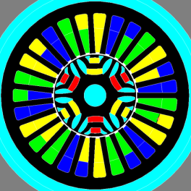
Cost Breakdown: Mass production estimates
 | Mass Density
Steel M19 | 7700 Kg/m3
Copper | 8960 Kg/m3
NdFeB | 7450 Kg/m3
 | S550 |  |  | PMSynRM |  |  | PMSynRM
Length | 43mm |  |  | 60mm |  |  | 66mm
 | Volume (m3) | Mass (Kg) | Part Cost (US$) | Volume (m3) | Mass (Kg) | Part Cost (US$) | Volume (m3) | Mass (Kg) | Part Cost (US$)
Rotor Core | 3.36e-5 | 0.26 | 0.34 | 4.14e-5 | 0.32 | 0.41 | 4.55e-5 | 0.35 | 0.46
Stator Core | 12.1e-5 | 0.93 | 2.98 | 15.88e-5 | 1.22 | 3.90 | 17.5e-5 | 1.35 | 4.32
Copper (slot+endturns) | 5.266e-5 | 0.48 | 3.17 | 7.44e-5 | 0.70 | 4.62 | 7.18e-5 | 0.65 | 4.29
Magnets | 1.08e-5 | 0.08 | 13.52 | 1.04e-5 | 0.078 | 11.04 | 1.15e-5 | 0.086 | 12.21
$20.01
$19.97
$21.30
N38SH x 1
N30SH x 0.84
Unit Cost = Cost per Kg
Rotor | 1.3 $/Kg
Stator | 3.2 $/Kg
Copper | 6.6 $/Kg
Magnets NdFeB 38SH | 169 $/Kg
PMSynRM uses
an equivalent to
NdFeB 27SH

Slide 4
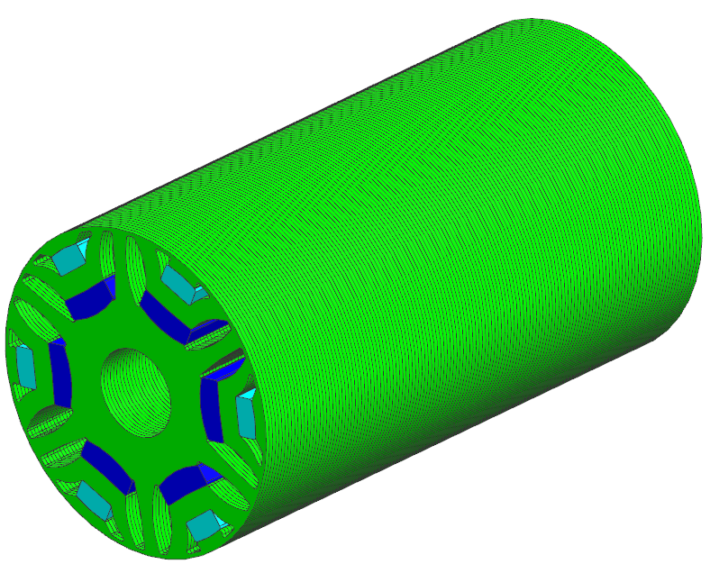
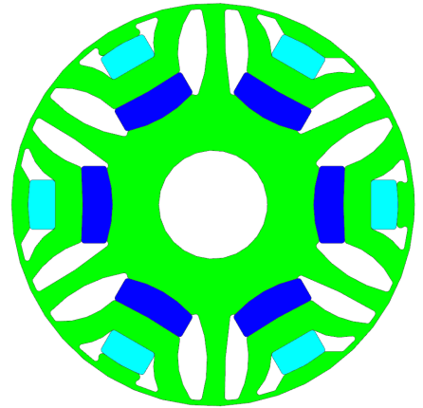
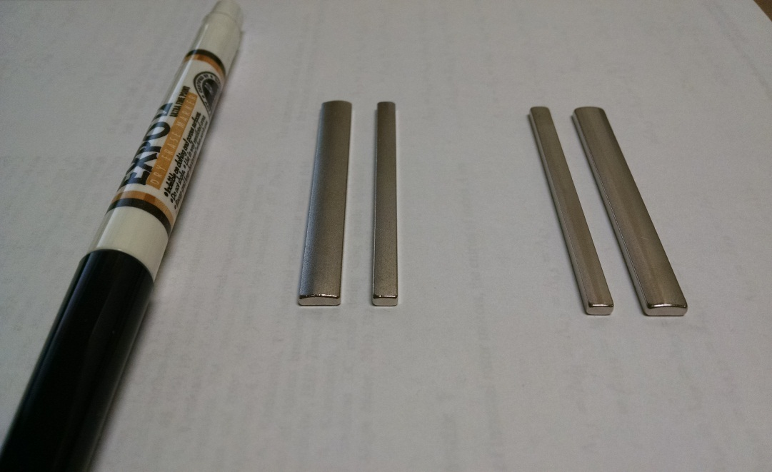
Status Update:
Prototype Stage
Sintered Magnets received (SmCo26
and NdFeB28)
10 Stator/Housing received (T1xx/K2xx), shaft, bearings, etc.
Rotor Laminations from LH ~2 weeks (July 3rd)
Injected Molded Magnets (MagFine Dy-free) on hold, after confirming performance on IMM project.
Testing Stage
Power-off and Power-on tests and results ~2 weeks after prototypes assembled.
Samarium Cobalt
SmCo26
Neodymium
NdFeB 28

